Slide 1
Alcohol Pricing Strategies
88,000
Alcohol pricing strategies impose higher taxes on alcoholic beverages to reduce excessive drinking, underage drinking and alcohol-related deaths.
people die of alcohol-related causes each year.

Slide 2
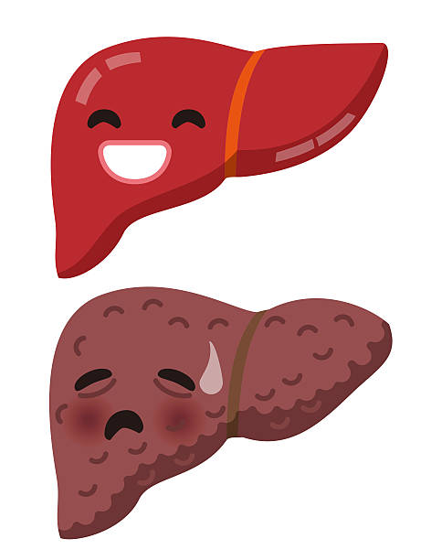
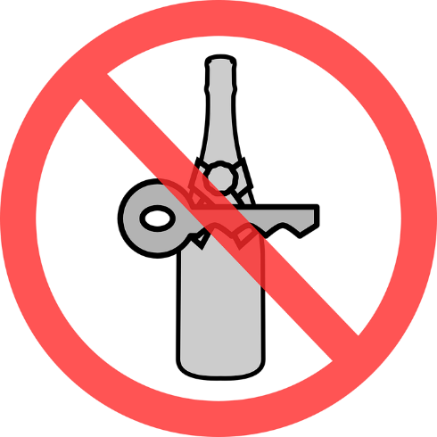
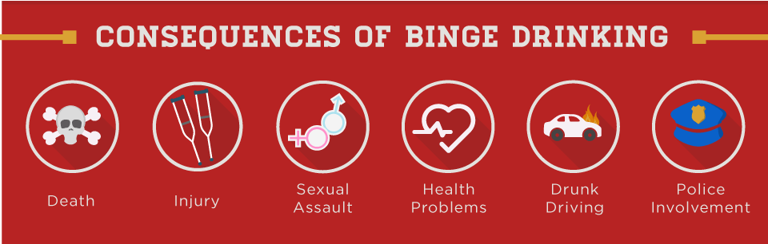
Alcohol Pricing Strategies
Health Benefits
Economic Benefits
Reduced overall alcohol consumption
Reduced alcohol-related vehicle crashes
Reduced mortality from liver cirrhosis
Reduced alcohol-related violence
In 2010, excessive alcohol use cost the United States an estimated $249 billion in medical care
More than 70 percent of costs were related to binge drinking

Slide 3
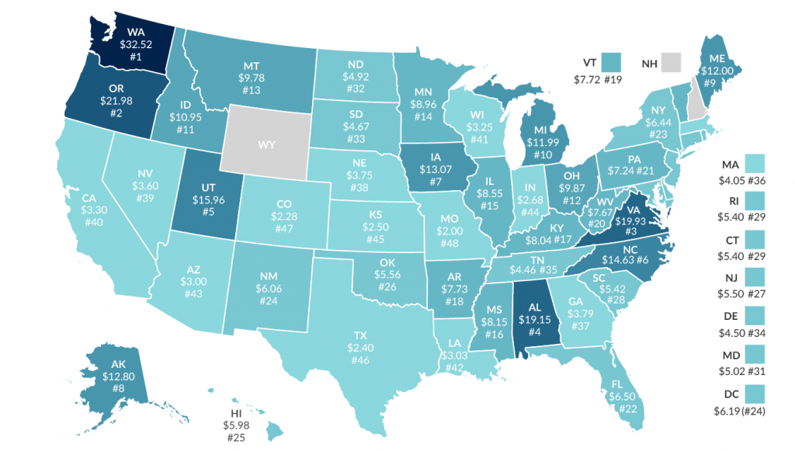

Alcohol Pricing Strategies
Distilled Spirits Excise Tax Rates (Dollar per Gallon)
In some states different rates are applicable to alcohol content, place of production, size of container, or place purchased.
Distilled Spirits Council of the United States

