Slide 1
Complete Streets
5,977
Complete streets are a transportation network that addresses the needs of all road users including pedestrians, bicyclists, motorists and transit riders, regardless of age or ability.
pedestrian fatalities occurred in 2017.

Slide 2


Complete Streets
Health Benefits
Economic Benefits
Increase activity and make being active easier
Lower rates of overweight and obesity
Reduced vehicle collisions
Increased accessibility
Avoid healthcare costs associated with hypokinetic diseases
Have the potential to benefit a community economically
Usually not additive costs

Slide 3
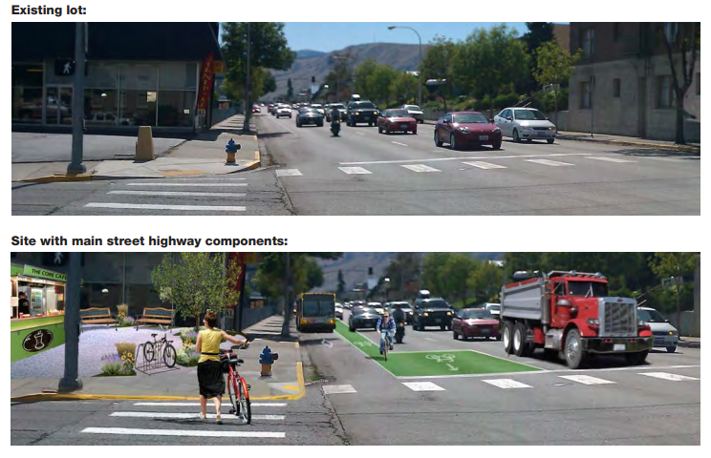
Complete Streets
29 states and D.C. have adopted Complete Streets policies with mandatory requirements.
Case Example: Washington’s Complete Streets
Rehabilitated small-town main streets
Determined that complete streets project would save an average of $9 million per project or 30 percent
Incorporated sidewalks, safe crossings, on-street parking and more
Resulted in savings
Washington State Department of Transportation (WSDOT)

