Slide 1
Earned Income Tax Credit
The state earned income tax credit (EITC) assists families and in some states, adults without dependent children, by reducing qualifying taxpayers’ tax liability based on income level, marital status and number of dependent children.
9.4 million
people in working families were raised above the poverty line by the EITC in 2017.

Slide 2


Earned Income Tax Credit
Health Benefits
Economic Benefits
Associated with decreased low-birthweight births
Increased breastfeeding rates
Improved maternal and child health
Helped lift 9.4 million families out of poverty in 2017, including more than 5 million children
Reduced the severity of poverty for an additional 18.7 million families
Encourages single mothers to enter the work force

Slide 3
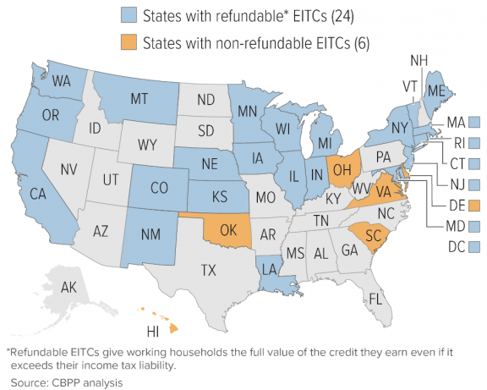
Earned Income Tax Credit
29 states and D.C. have enacted a state-level EITC law
3 states and D.C. offer ETIC to workers without dependent children
New York and D.C. also offer EITC to non-custodial parents
Center on Budget and Policy Priorities (CBPP)

