Slide 1
Earned Sick Leave
38%
State policies that support earned sick leave allow employees to take time off from work to recover when they are ill or need to visit a healthcare provider.
of US workers do not have access to earned sick leave.

Slide 2


Earned Sick Leave
Health Benefits
Economic Benefits
Increased access to preventive healthcare services
Decreased rates of flu infections
Reduced risk of illness
Decreased spread of infection
Employees are less likely to delay medical care
Minimal costs to employers
Costs more to have sick employees at work
Reduces turnover
Increased productivity when employees are healthy at work

Slide 3
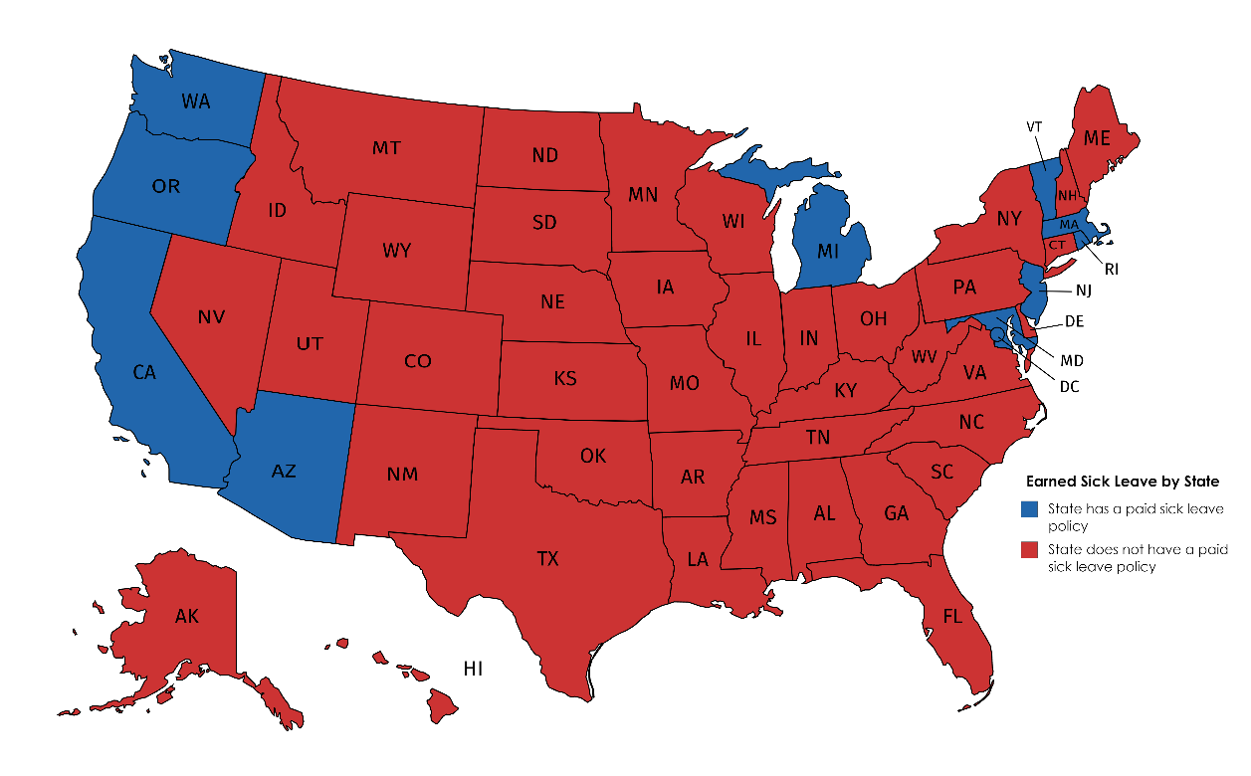
Earned Sick Leave
Earned Sick Leave Policies by States
Case Example: Arizona
Law went into effect in 2017
Guarantees 40 hours of annual earned sick leave to employees of companies with 15 or more employees
Guarantees 24 hours of sick leave to employees of companies with fewer than 15 employees
Employers required to provide one hour of sick leave to each employee for every 30 hours worked

