Slide 1
Fair Hiring Protections (Ban the Box)
1 in 3
Fair hiring protections such as Ban the Box (BTB) laws give applicants with criminal records an opportunity to be considered for jobs based on their qualifications not their conviction history.
American adults have a criminal record.

Slide 2


Fair Hiring Protections (Ban the Box)
Health Benefits
Economic Benefits
Increased employment for justice-involved individuals
Facilitates achievement of economic well-being which influences health outcomes
Evidence suggests that BTB laws can curb recidivism
Most employers reported BTB laws having minimal impact on their hiring processes
Increases state income tax contributions
Increases lifetime earnings for justice-involved individuals
Saves taxpayer money by curbing recidivism

Slide 3
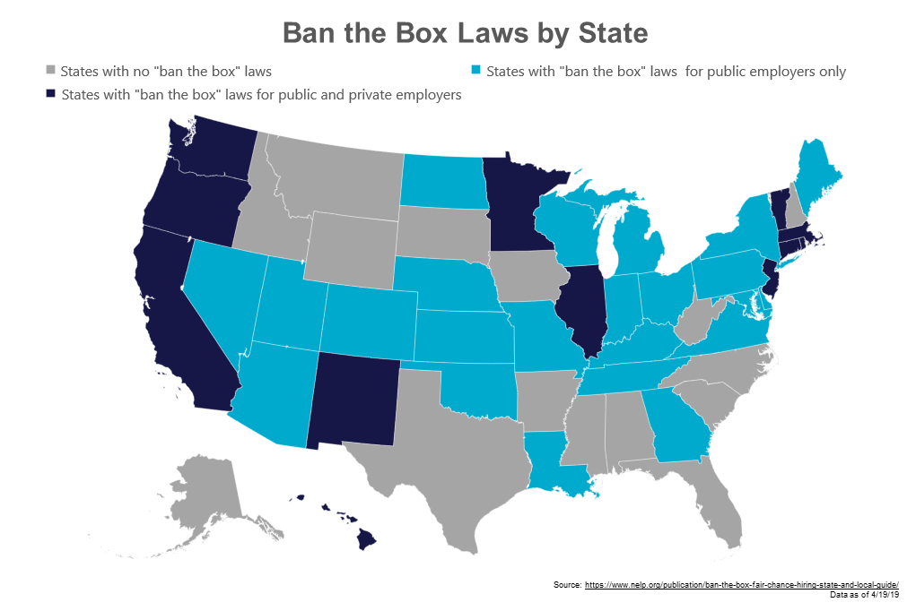
Fair Hiring Protections (Ban the Box)
33 states and D.C. have BTB laws applying to public employers
11 states also apply to private employers
More than 150 cities and counties have enacted BTB
5 states pre-empt local governments from enacting BTB

