Slide 1
Housing Rehabilitation Loan & Grant Programs
40%
Housing rehabilitation loan and grant programs provide funding to repair or improve homes, or to remove health or safety hazards from homes.
of US houses have one or more health hazards

Slide 2

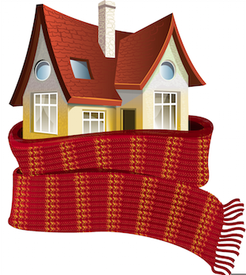
Housing Rehabilitation Loan & Grant Programs
Health Benefits
Economic Benefits
Positive effects on overall physical and mental health
Reduce hospitalizations, doctor’s visits and absences from school and work
Decrease disparities in access to quality housing and associated health outcomes
Benefits derived from improvements to health and energy efficiency exceed the cost of installing insulation
Reduce days off school and work and increase productivity
Reduced energy bills provide low-income individuals with more income

Slide 3
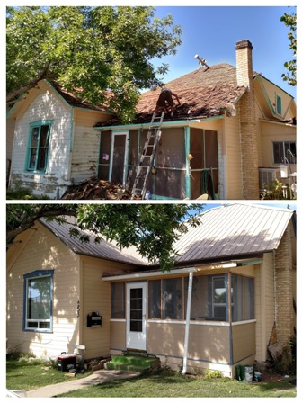
Housing Rehabilitation Loan & Grant Programs
Before
39 states and D.C. have laws related to housing rehabilitation loans and grants
At least six states have laws that provide some level of detail
Most laws simply allow or require state agencies or municipalities to use funds for housing rehabilitation
After
Delta Housing Authority

