Slide 1
Paid Family Leave
Only
13%
State policies that support paid family leave allow employees to take paid time off for events like a recent birth or adoption of a child, taking care of a family member with a serious medical condition or caring for a sick child.
of private-industry employees have access to paid family leave.

Slide 2



Paid Family Leave
Health Benefits
Economic Benefits
Decreased disparities
Reduced risk of birth-related health issues for mothers and their babies
Reduced death among infants and young children
Improved caregiver mental health
Increased employee retention
Increased likelihood that mothers remain in the workforce after childbirth
Offers economic security to caregivers
Decreased dependency on public assistance

Slide 3
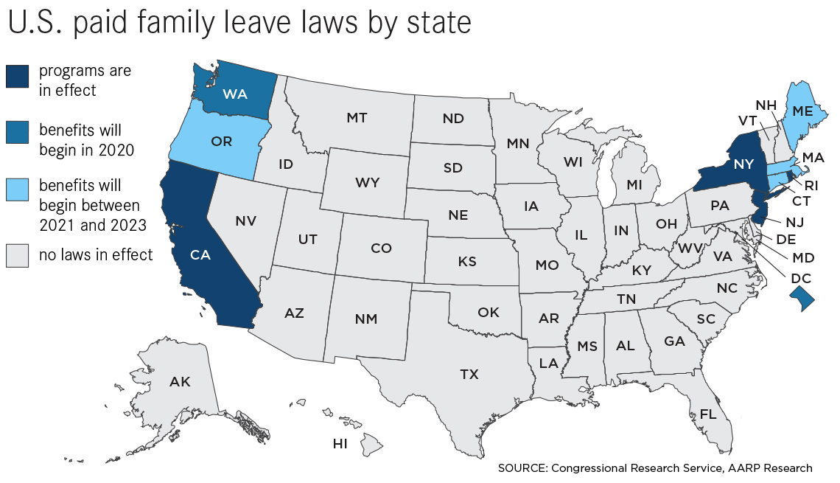
Paid Family Leave
State policies range from four weeks to twelve weeks of paid leave
Vary in the eligibility requirements for the program

