Slide 1
Rapid Re-Housing/Housing First
552,830
Rapid re-housing programs provide temporary support services to help people experiencing homelessness move quickly into permanent housing.
People experienced homelessness in 2018.

Slide 2


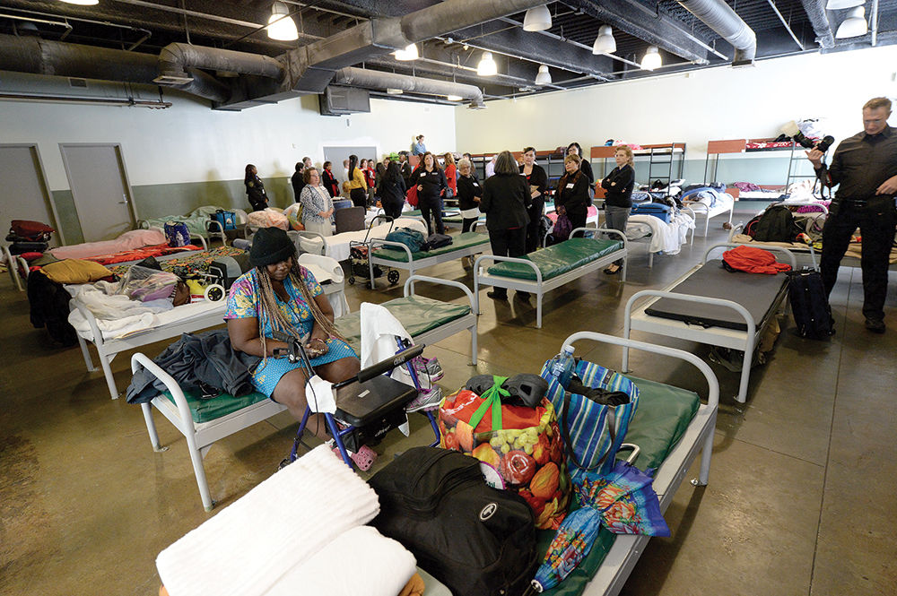
Rapid Re-Housing/Housing First
Health Benefits
Economic Benefits
Reduce homelessness and hospital use for populations with behavioral health issues
Reduce disparities
Improve housing stability
Increase access to social services
Decrease costs to shelters
Reduce emergency room use and costs
Reduce costs associated with acute care services
Reduce hospital admissions and jail bookings

Slide 3
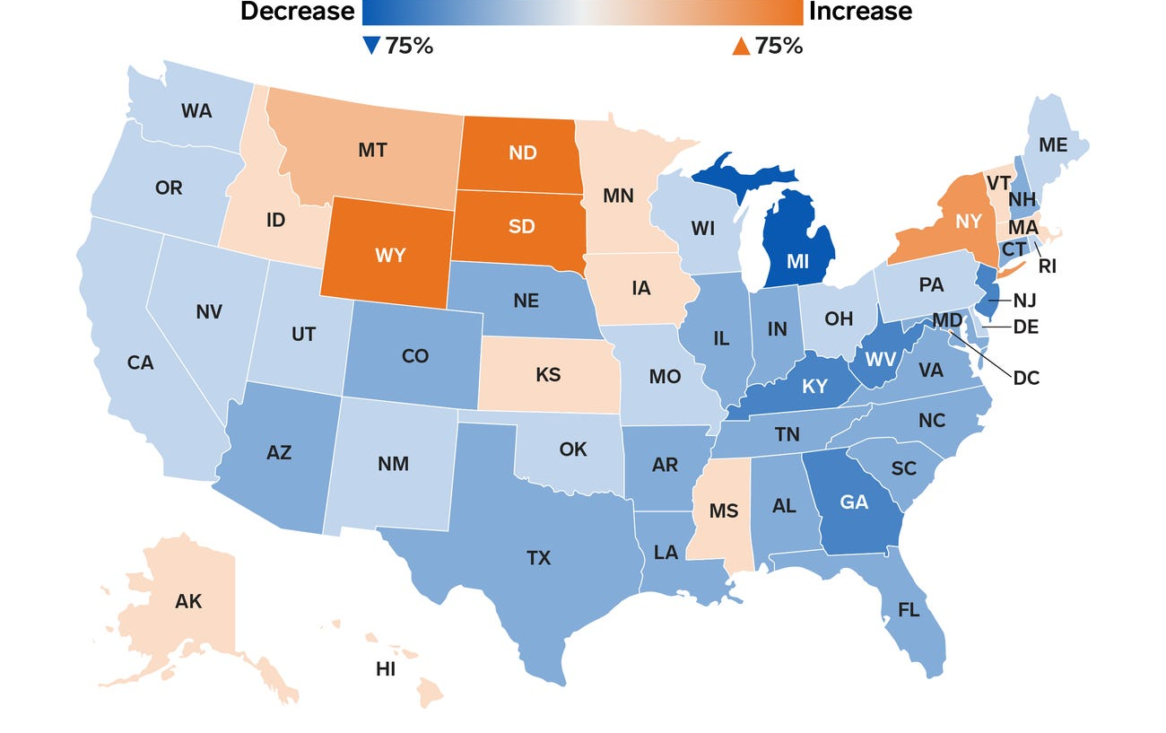
Rapid Re-Housing/Housing First
Percent Change in Homelessness 2007-2017
Nine states have enacted laws that specifically address rapid re-housing
States, counties and municipalities have all implemented rapid re-housing programs
Many programs are also administered by local non-profit organizations
Department of Housing and Urban Development

