Slide 1
Smoke-Free Policies
$5.6 billion
Smoke-free policies are policies that prohibit smoking in designated spaces. Policies can apply to indoor areas, outdoor areas and multiunit housing.
in lost productivity due to secondhand smoke exposure each year.

Slide 2


Smoke-Free Policies
Health Benefits
Economic Benefits
Decreases smoking behavior
Reduces exposure to secondhand smoke
Reduce asthma attacks and related hospitalizations
Promote smoking cessation
Reduce secondhand smoke exposure and related medical expenditures
Do not create significant burdens on staff or budgets

Slide 3
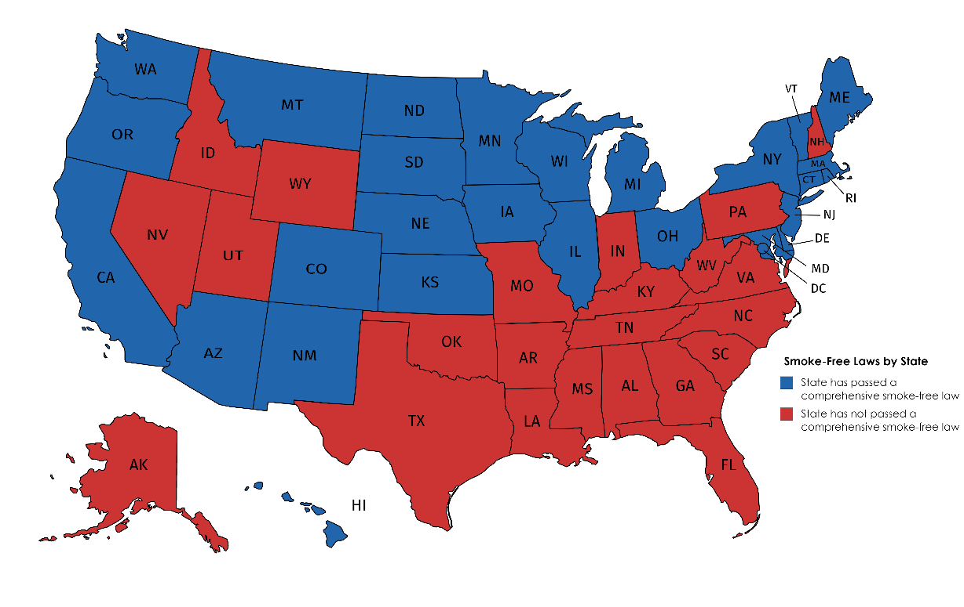
Smoke-Free Policies
Status of Comprehensive Smoke-Free Laws by State
9 states and D.C. have added e-cigarettes to their smoke-free laws
37 states and D.C. are 100% smoke-free in at least one of three locations (bars, restaurants and private worksites)

