Slide 1
Syringe Access Programs
$84,000
Syringe Access Programs are the legal sale and exchange of sterile syringes to reduce the rate of infections diseases among persons who inject drugs.
is the starting cost of treatment for Hepatitis C.

Slide 2
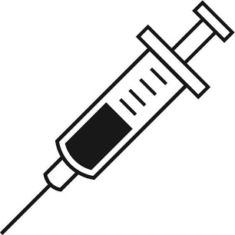
Syringe Access Programs
Health Benefits
Economic Benefits
One of the most effective and scientifically-based methods for reducing spread of HIV and hepatitis
Do not contribute to increased drug use
Following implementation in NYC HIV prevalence among injection drug users fell from 50% to 17%
Cost of treatment for blood-borne diseases can be extremely costly
  HIV treatment = ~$379,000
  HCV treatment = $84-90,000
Implementation in NYC resulted in baseline one-year savings to the government of $1,300-$3,000 per client

Slide 3
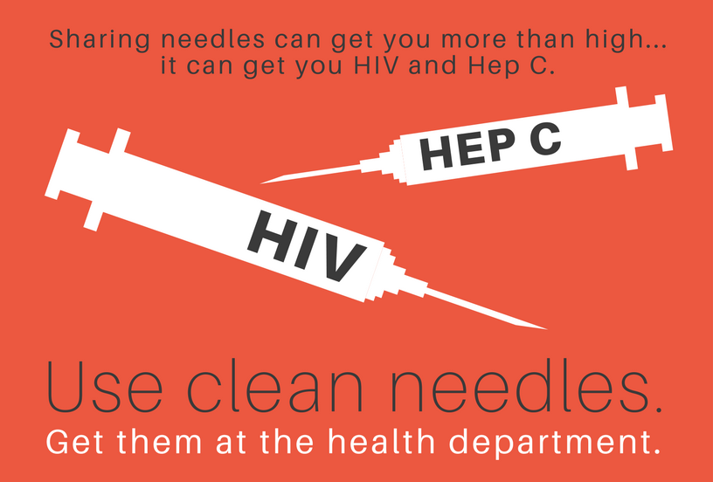
Syringe Access Programs
30 States & DC
have laws
supporting syringe access programs.
Awareness campaign for syringe exchange program run by the Buffalo Trade District Health Department in Kentucky.

