Slide 1
Tobacco Pricing Strategies
$170 billion
Tobacco pricing strategies increase the price of tobacco products in order to deter youth from using tobacco products, promote quitting smoking and reduce tobacco use.
in healthcare expenditures each year due to smoking.

Slide 2
Tobacco Pricing Strategies
Health Benefits
Economic Benefits
Decreases tobacco consumption
Increases rates of quitting tobacco
Have a greater effect on adolescents and young adults
Generate cost savings in the form of lower healthcare expenditures
Revenue can be used to fund tobacco control programs

Slide 3
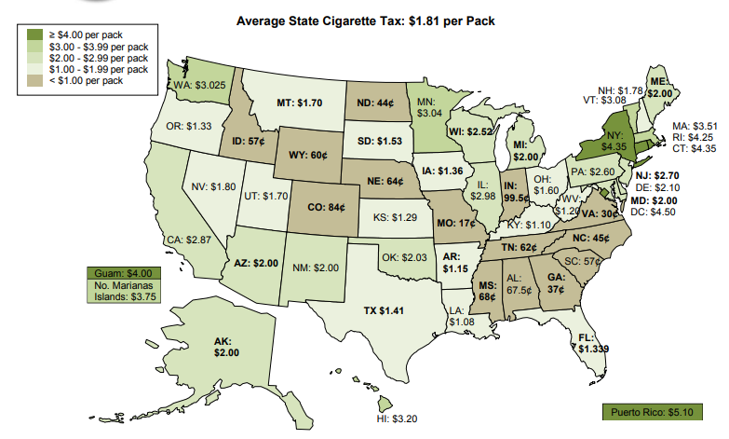
Tobacco Pricing Strategies
<$1.00 per pack: 14 states
$1.00 - $1.99 per pack: 16 states
$2.00 - $2.99 per pack: 12 states
$3.00 - $3.99 per pack: 5 states
>$4.00 per pack: 3 states and D.C.

