Slide 1
Universal Pre-Kindergarten
33%
Universal pre-kindergarten is publicly funded preschool offered to all 4-year-old children regardless of family income, the child’s abilities and other eligibility factors.
of 4-year-olds
are enrolled in
public pre-K programs.

Slide 2

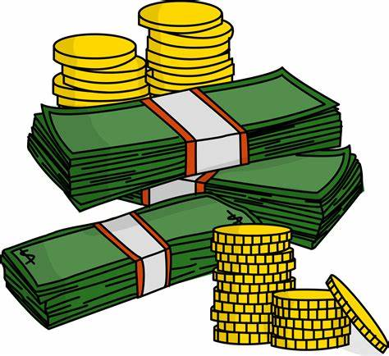

Universal Pre-Kindergarten
Health Benefits
Economic Benefits
Improved cognitive outcomes/academic knowledge
Reductions in teen birth and interactions with the criminal justice system
Increased high school graduation rates
Increased future earnings for participants
Reduced public spending on Medicaid and other social programs as a result of improved health outcomes

Slide 3
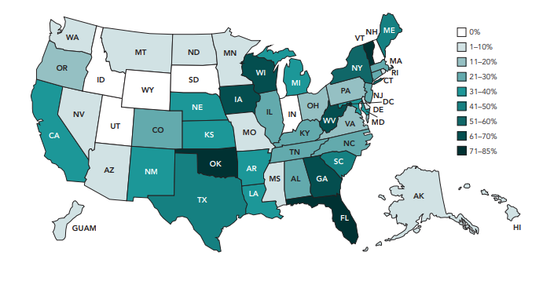
Universal Pre-Kindergarten
Case Example: West Virginia
Percent of 4-Year-Olds Enrolled in State Pre-K
Passed legislation in 2002
Required the state to make pre-K available to all 4-year-olds in the state
2012-2013 school year deadline
To date, WV pre-K programs was available in all 55 counties
NIEER State of Preschool 2018

