Slide 1
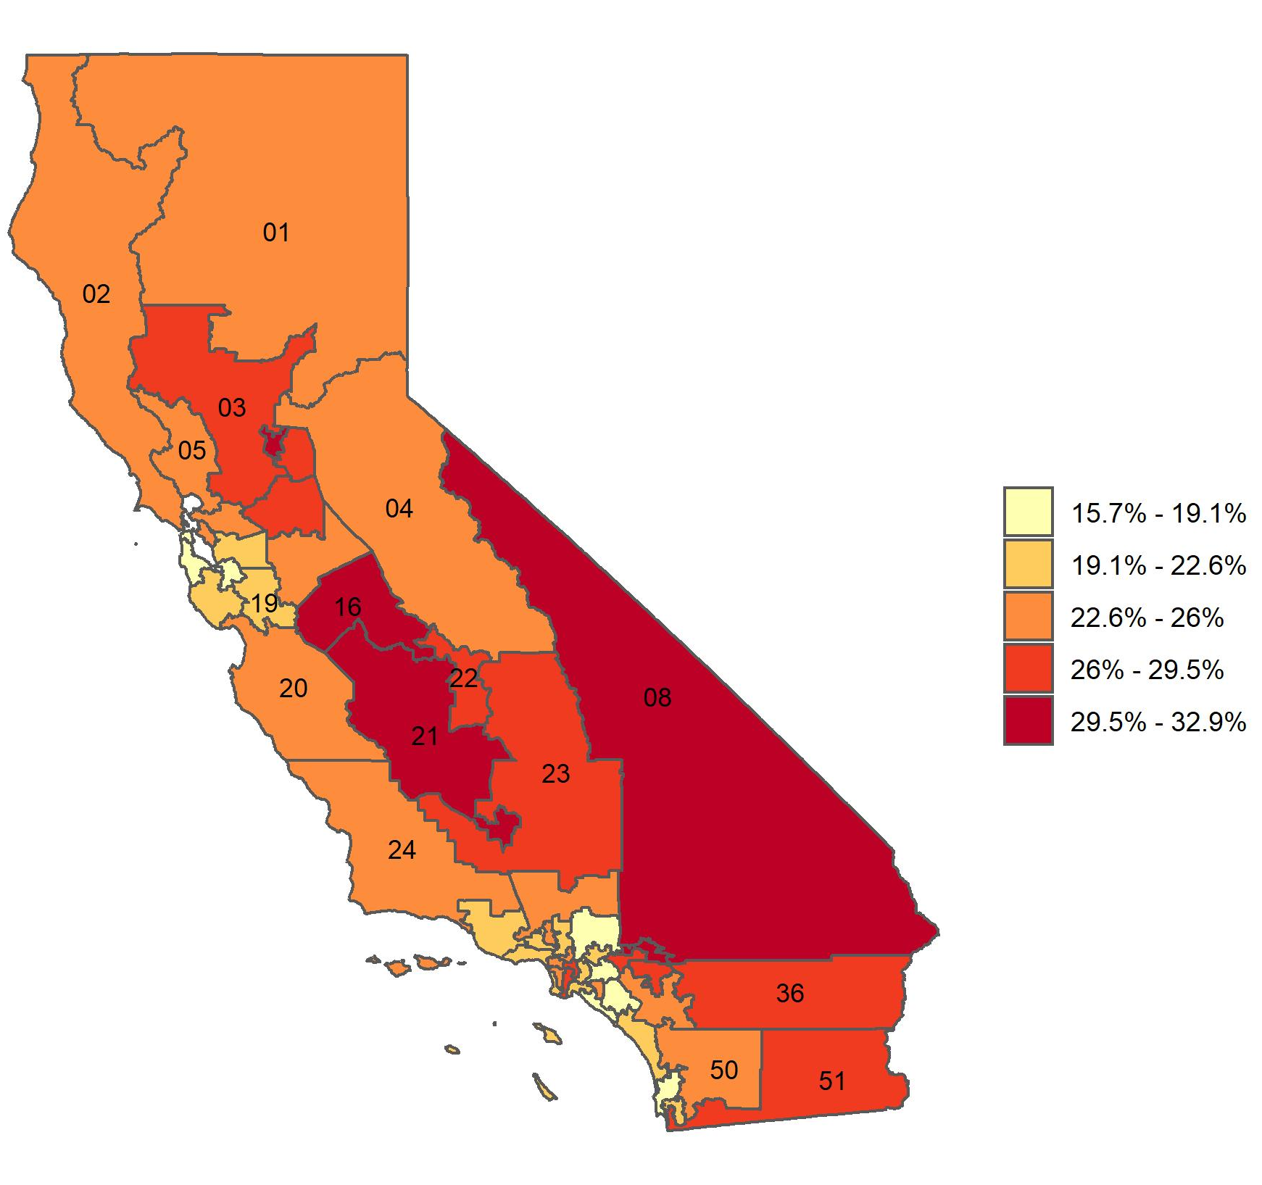
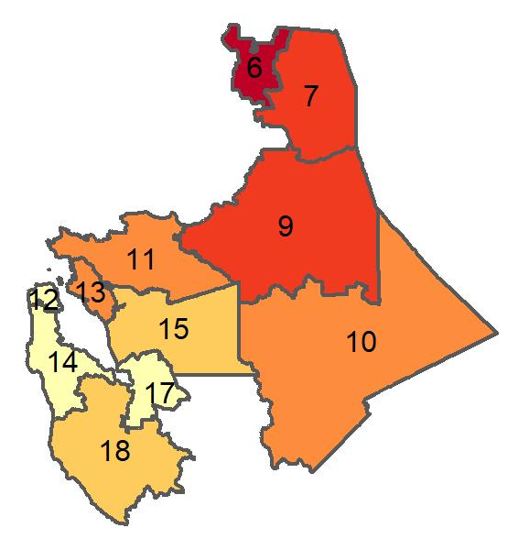
Percentage of adults with obesity in California, by congressional district
Source: Behavioral Risk Factor Surveillance System, CDC.

