Slide 1
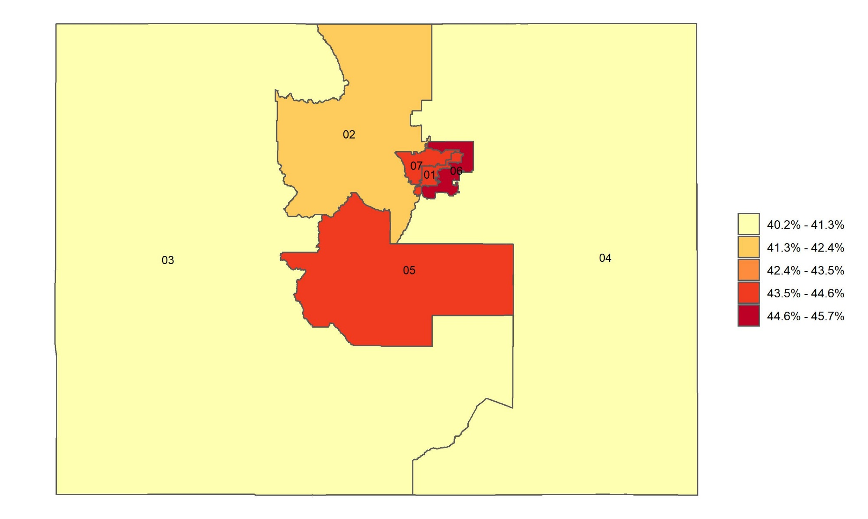
Percentage of adults who received a flu shot in the past 12 months in Colorado, by congressional district
Source: Behavioral Risk Factor Surveillance System, CDC.

