Slide 1
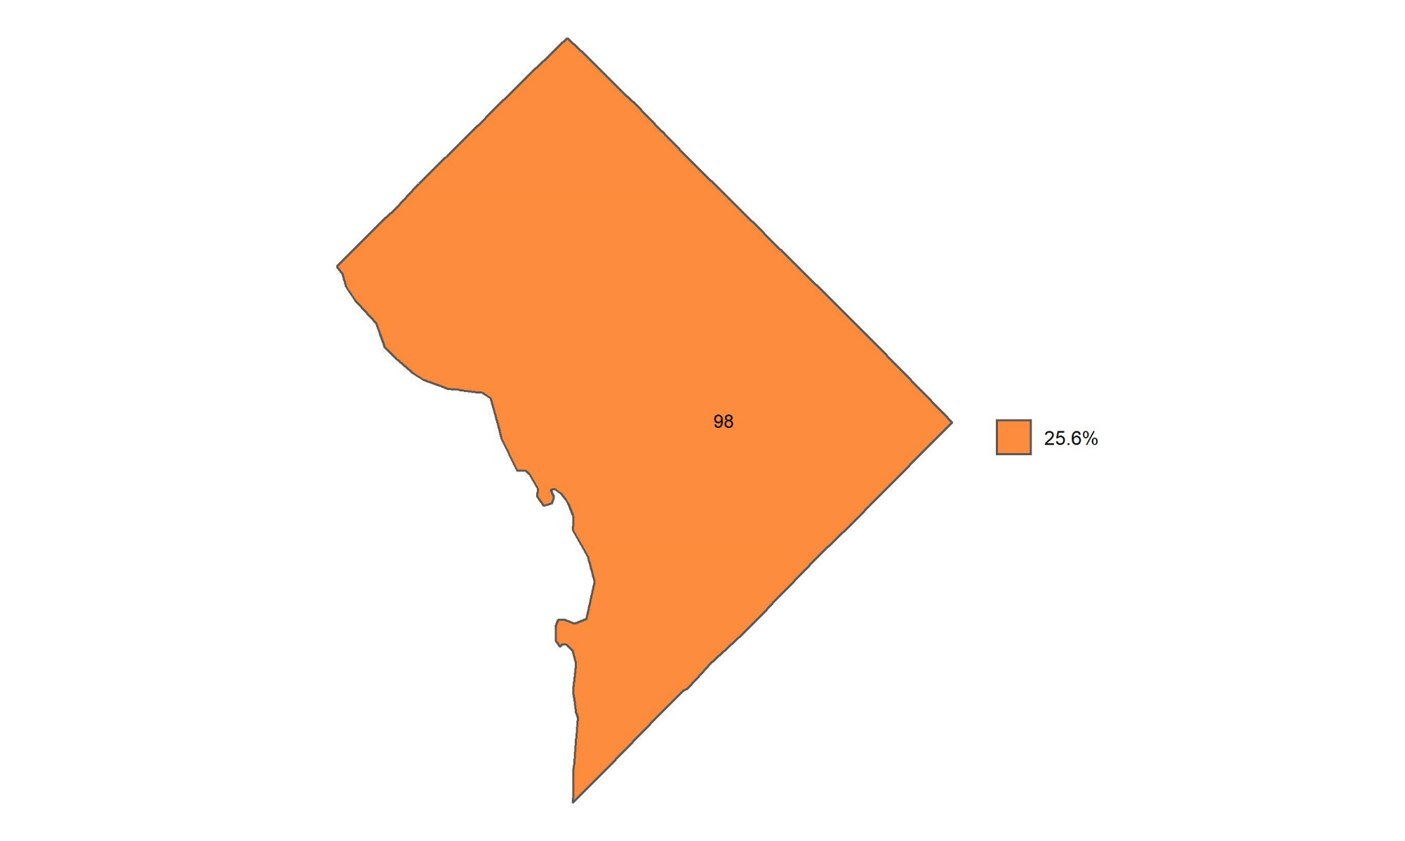
Percentage of adults with obesity in the District of Columbia
Source: Behavioral Risk Factor Surveillance System, CDC.

