Slide 1
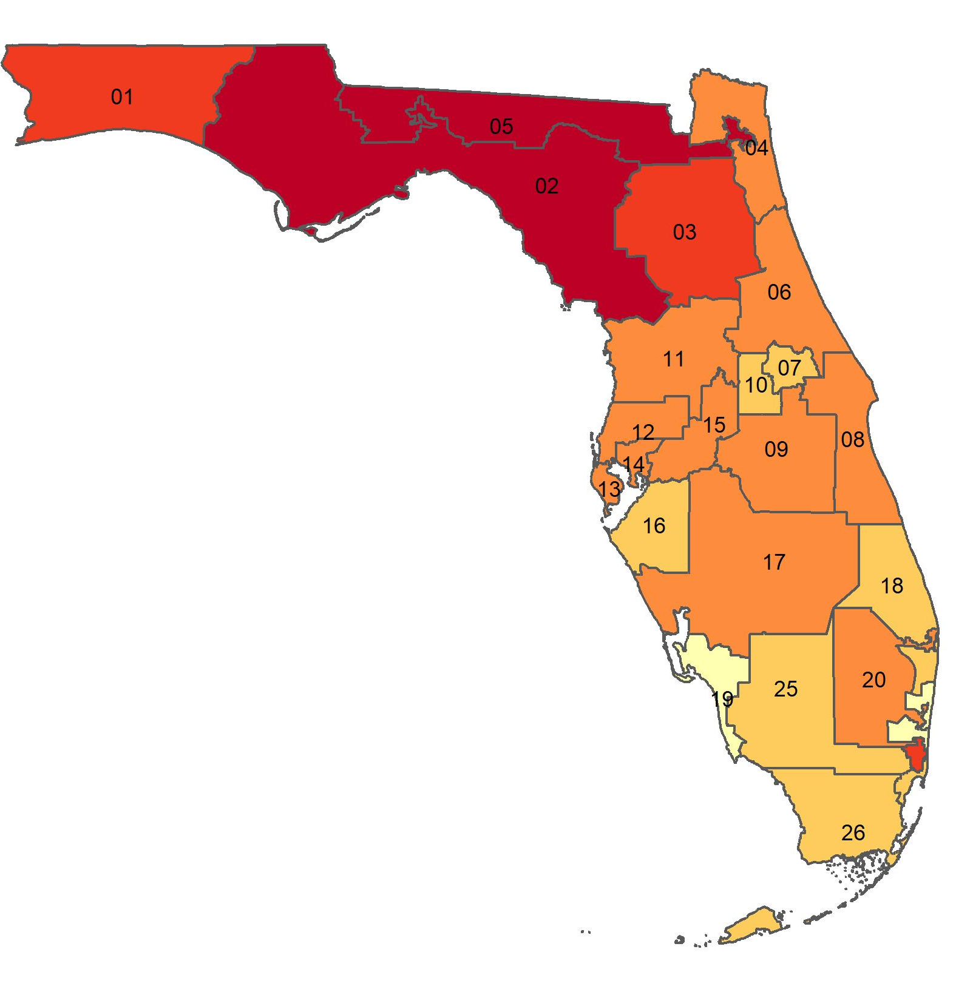
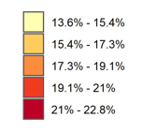
Percentage of adults in who smoke in Florida, by congressional district
Source: Behavioral Risk Factor Surveillance System, CDC.

