Slide 1
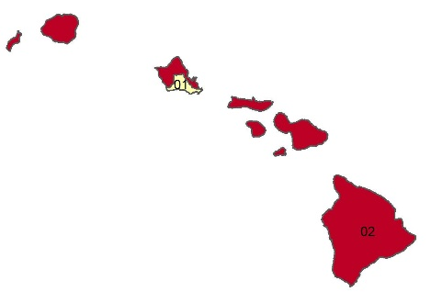

Percentage of adults who smoke in Hawaii, by congressional district
Source: Behavioral Risk Factor Surveillance System, CDC.

