Slide 1
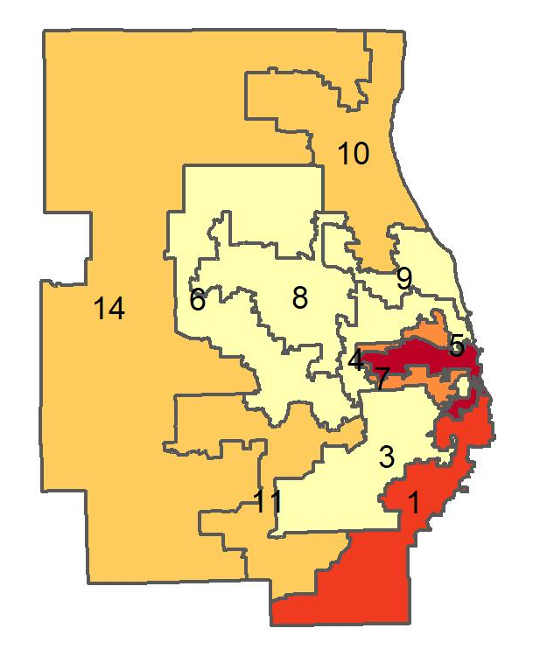
Percentage of adults in who smoke in Illinois, by congressional district
Source: Behavioral Risk Factor Surveillance System, CDC.

