Slide 1
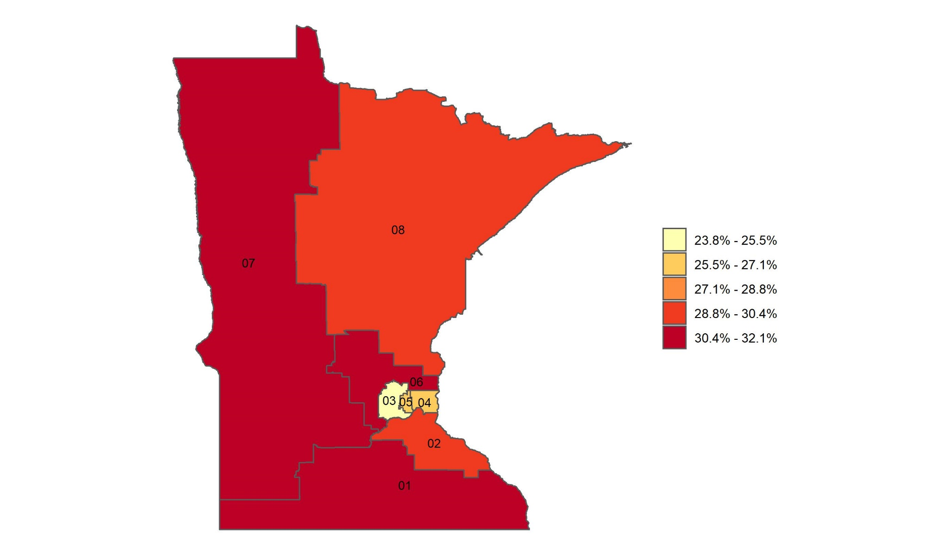
Percentage of adults with obesity in Minnesota, by congressional district
Source: Behavioral Risk Factor Surveillance System, CDC.

