Slide 1
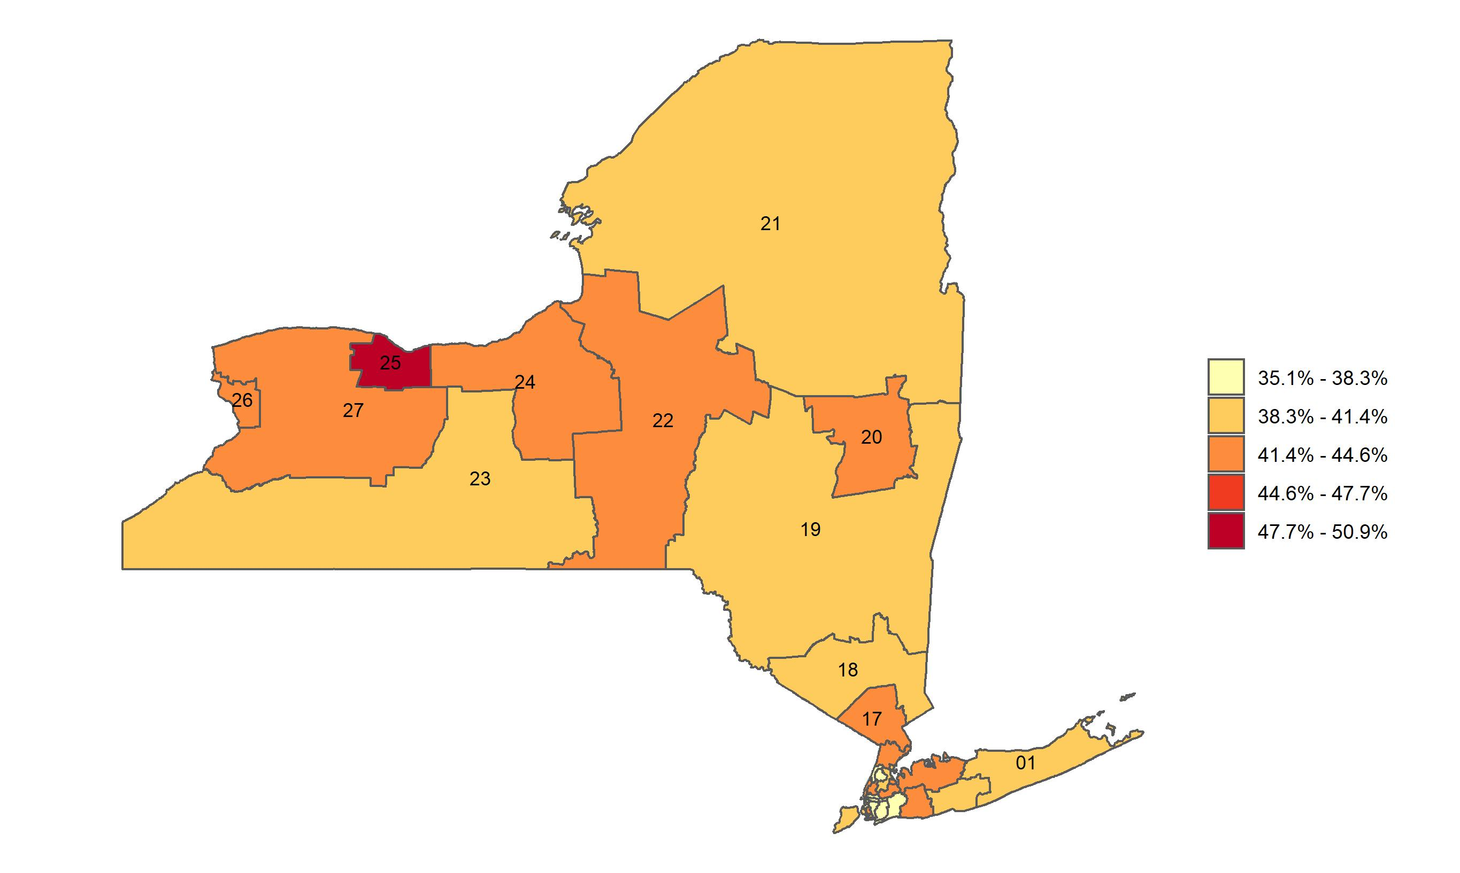
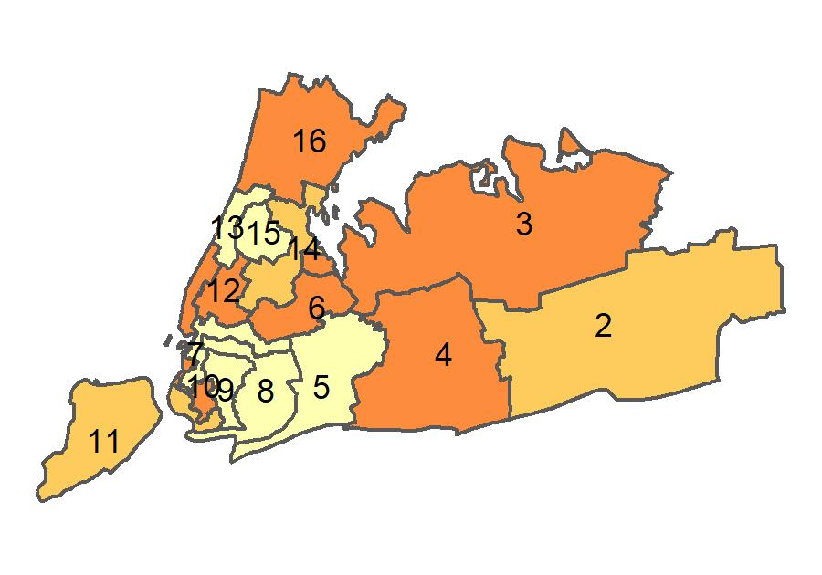
Percentage of adults who have received a flu shot in the past 12 months in New York, by congressional district
Source: Behavioral Risk Factor Surveillance System, CDC.

