Slide 1
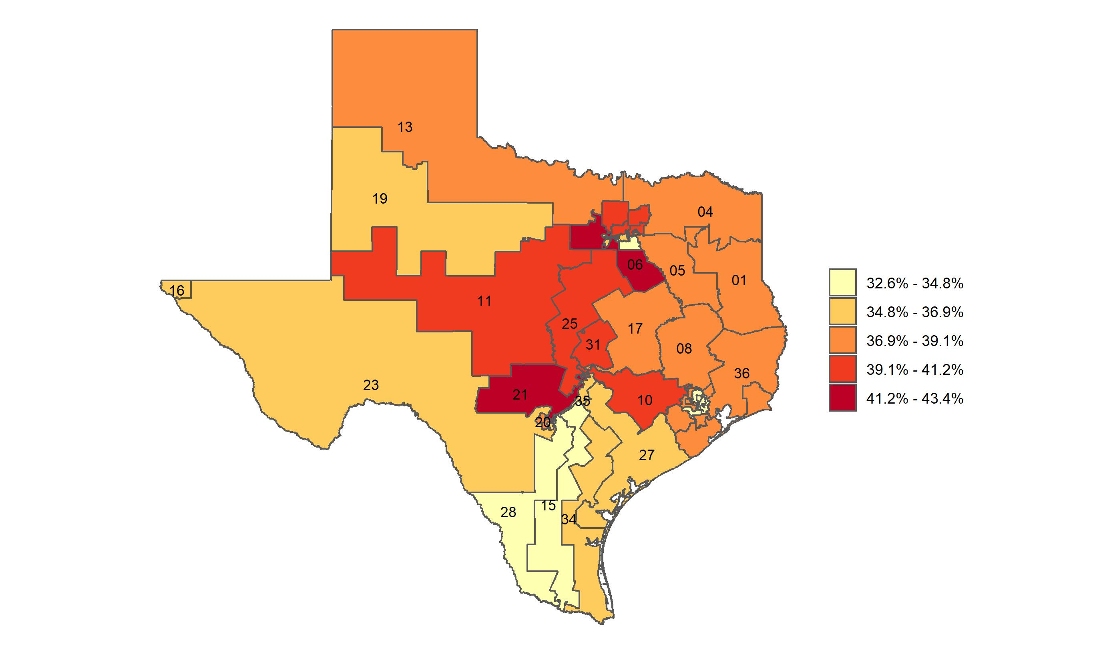
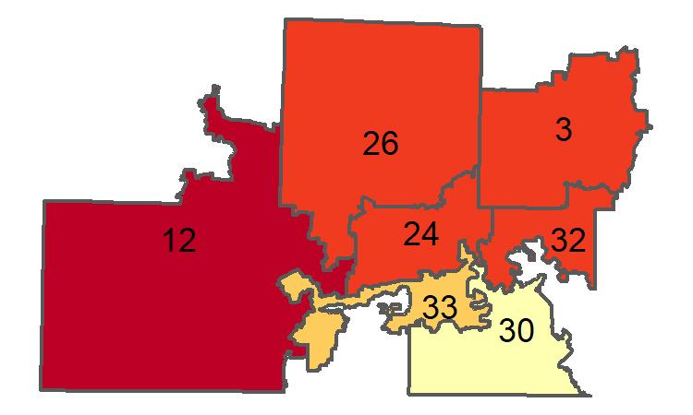
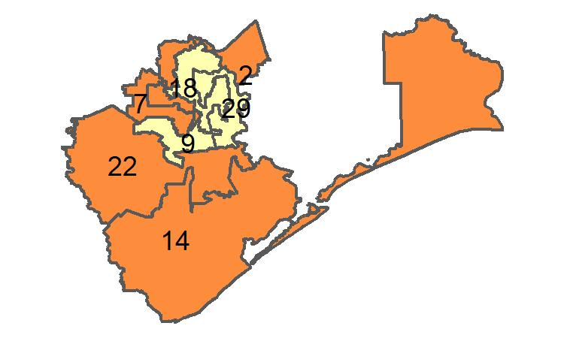
Percentage of adults who have received a flu shot in the past 12 months in Texas, by congressional district
Source: Behavioral Risk Factor Surveillance System, CDC.

