Slide 1
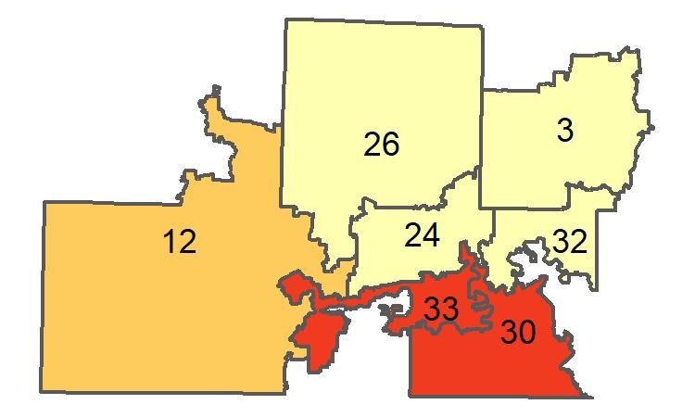
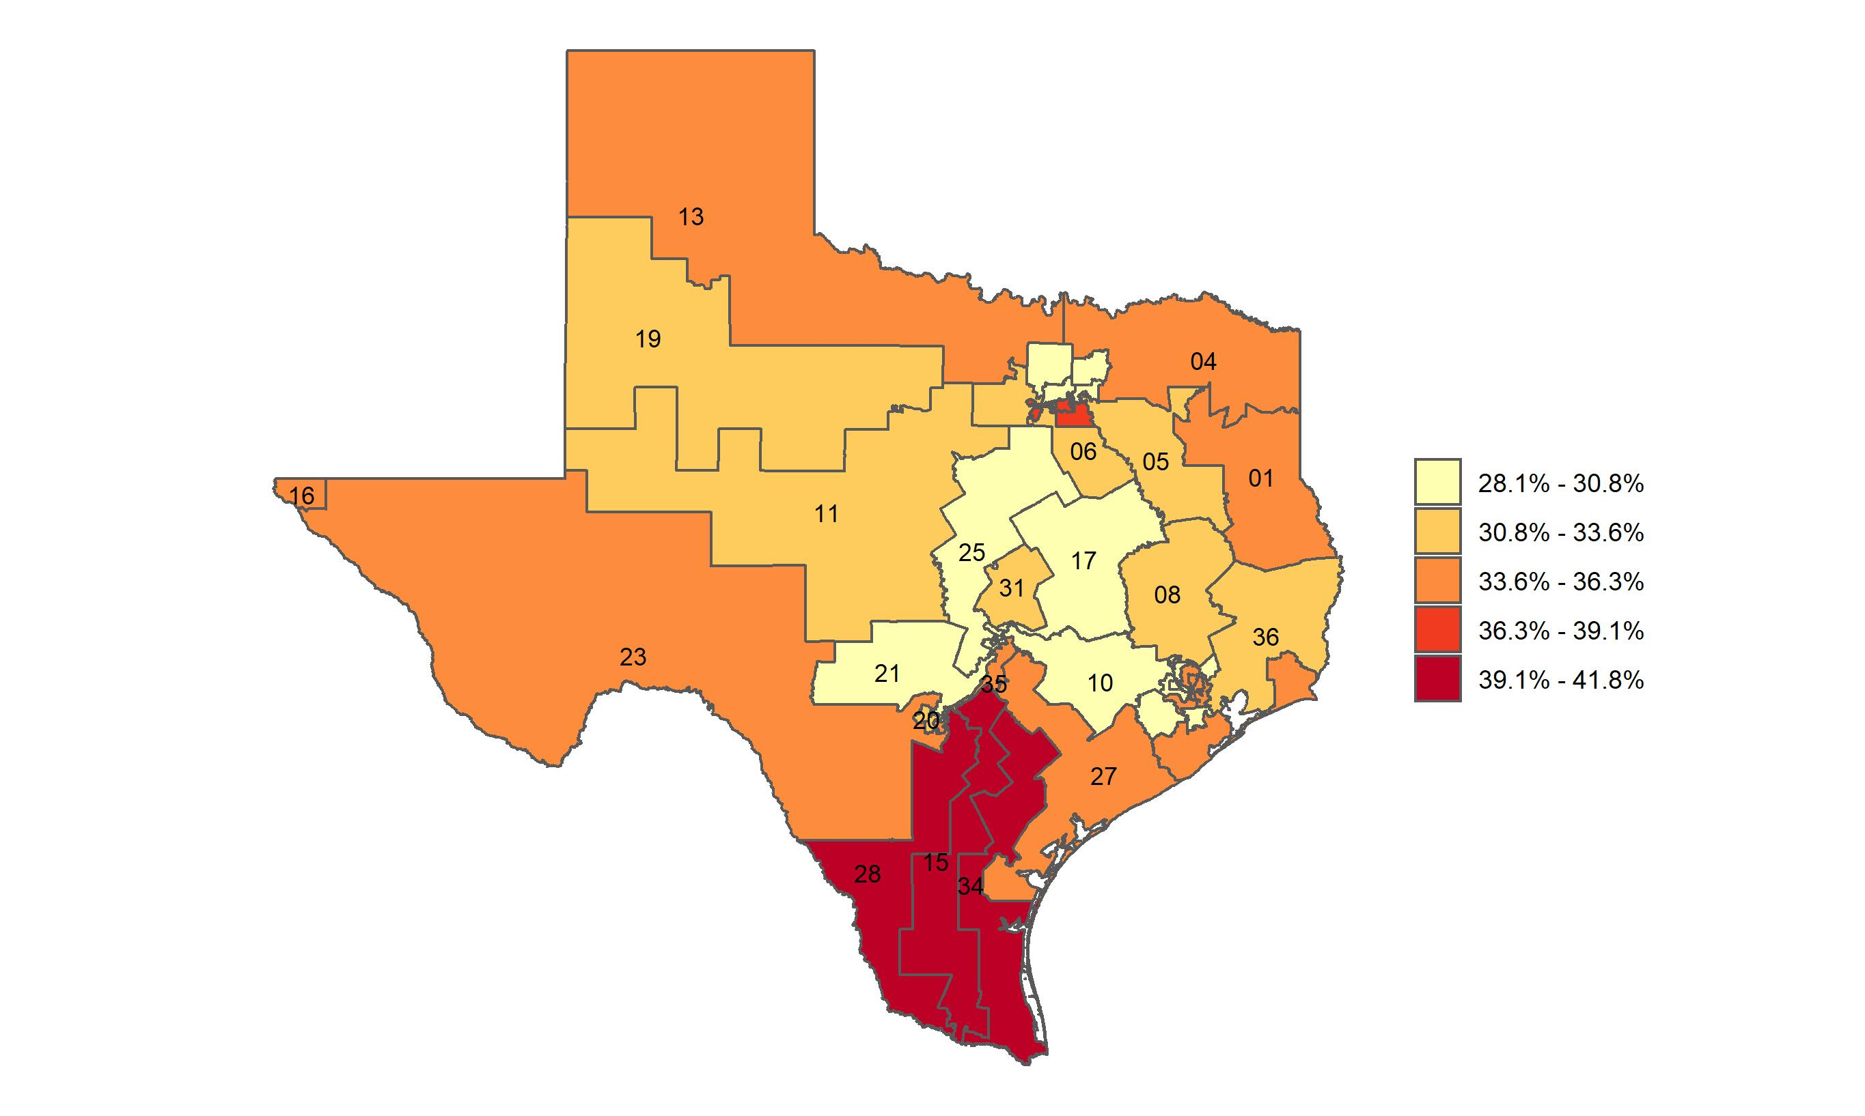
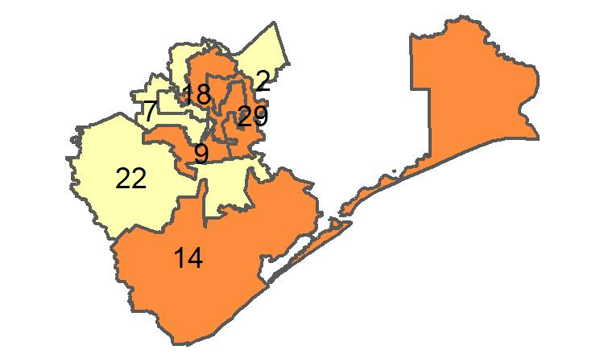
Percentage of adults with obesity in Texas, by congressional district
Source: Behavioral Risk Factor Surveillance System, CDC.

