Slide 1
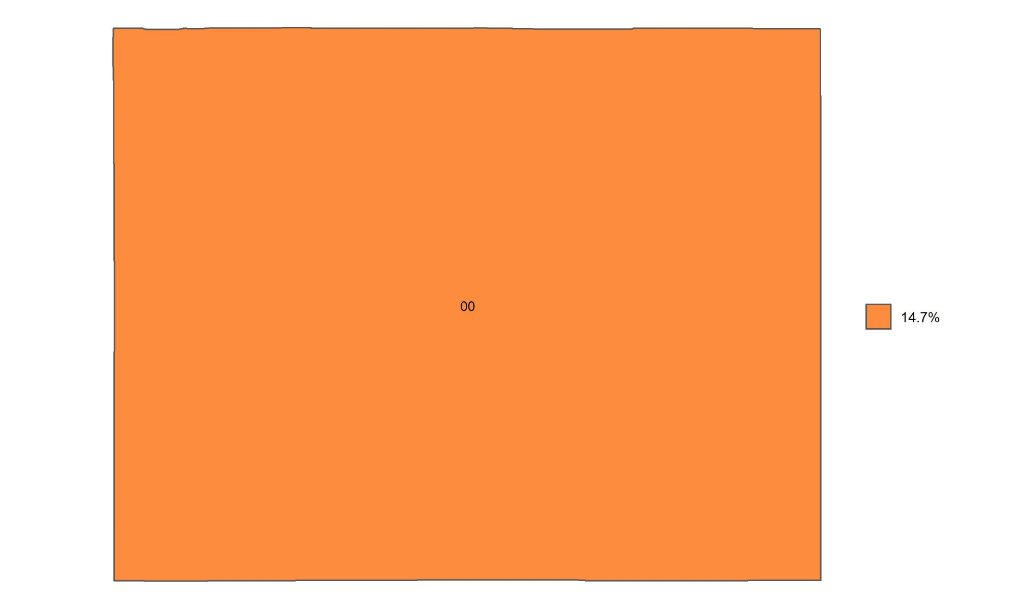
Percentage of 18-64 year olds with no health insurance in Wyoming, by congressional district
Source: Behavioral Risk Factor Surveillance System, CDC.

