Slide 1

NOTABLE AFRICAN AMERICANS IN PUBLIC HEALTH

Slide 2
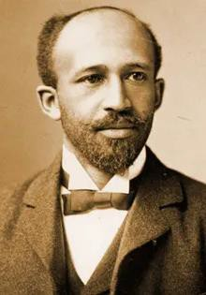

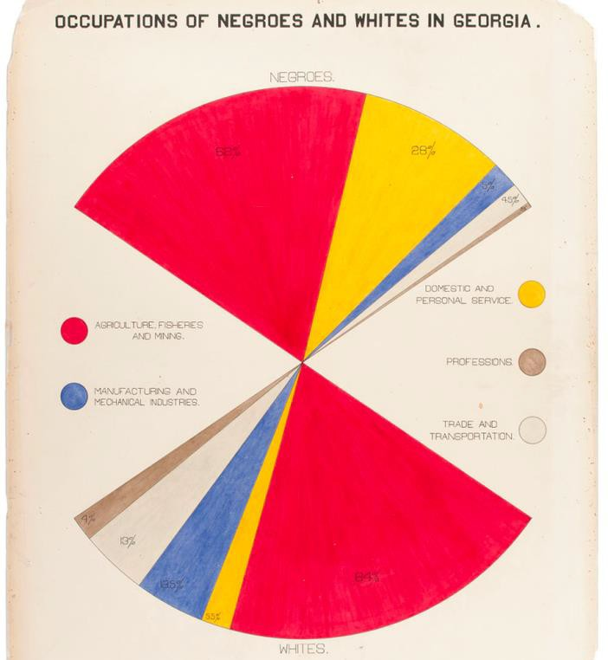
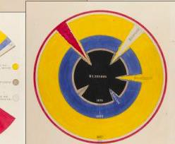
W. E. B. DU BOIS ( 1868 - 1963 )
Harvard trained sociologist and scholar activist
Groundbreaking ethnographic research including: The Philadelphia Negro & The Souls of Black Folks
Presented Exhibit of American Negroes at the 1900 Paris Exposition, visualizing the “nation within a nation” facing Black America

Slide 3
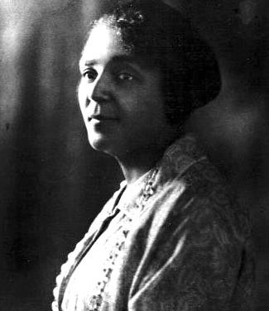
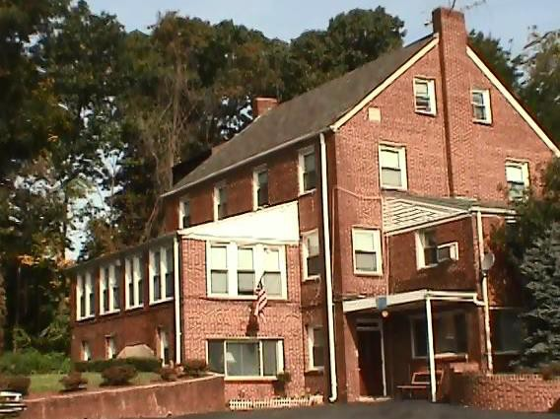
IONIA ROLLIN WHIPPER ( 1872 - 1953 )
Howard University trained physician in obstetrics
Served as a medical officer, public health educator and advocate
Established Ionia R. Whipper Home for Unwed Mothers, (first and only maternity home available to DC's African American women)
The Whipper Home continues to operate as shelter for homeless women

Slide 4
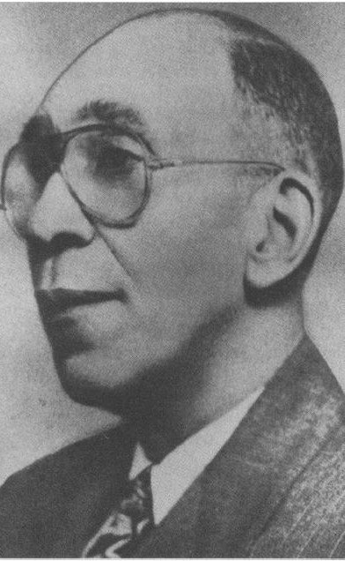
ROSCOE CONKLING BROWN SR. ( 1884 - 1963 )
Washington, D.C. native, Howard University trained dentist and public health pioneer
Served as an instructor in hygiene and sanitation at the Richmond Hospital Training School for Nurses
First chief of the Office of Negro Health Work, which he helped transfer to the Special Programs Branch, Division of Health Education of the Public Health Service
Member of President Franklin Roosevelt’s informal “Black Cabinet,” representing the needs of African Americans during the New Deal.

Slide 5
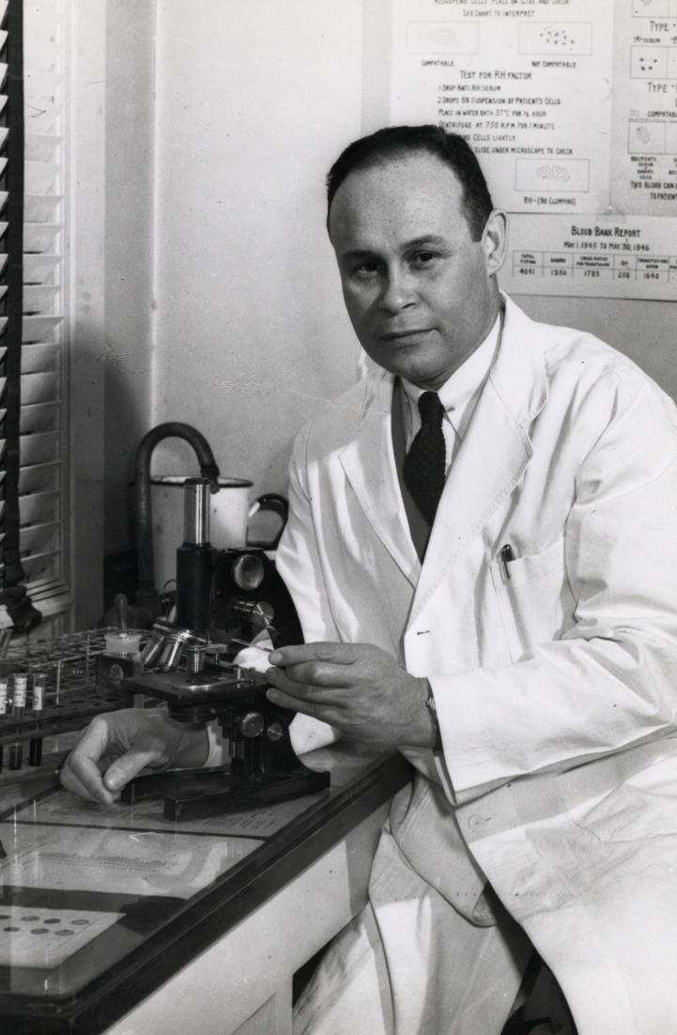
CHARLES R. DREW ( 1904 - 1950 )
Surgeon and medical researcher
Developed a method to preserve blood plasma for transfusions leading to creation of large-scale blood banks used in WWII
Director of the first American Red Cross Blood Bank Protested racial segregation in the donation of blood

Slide 6
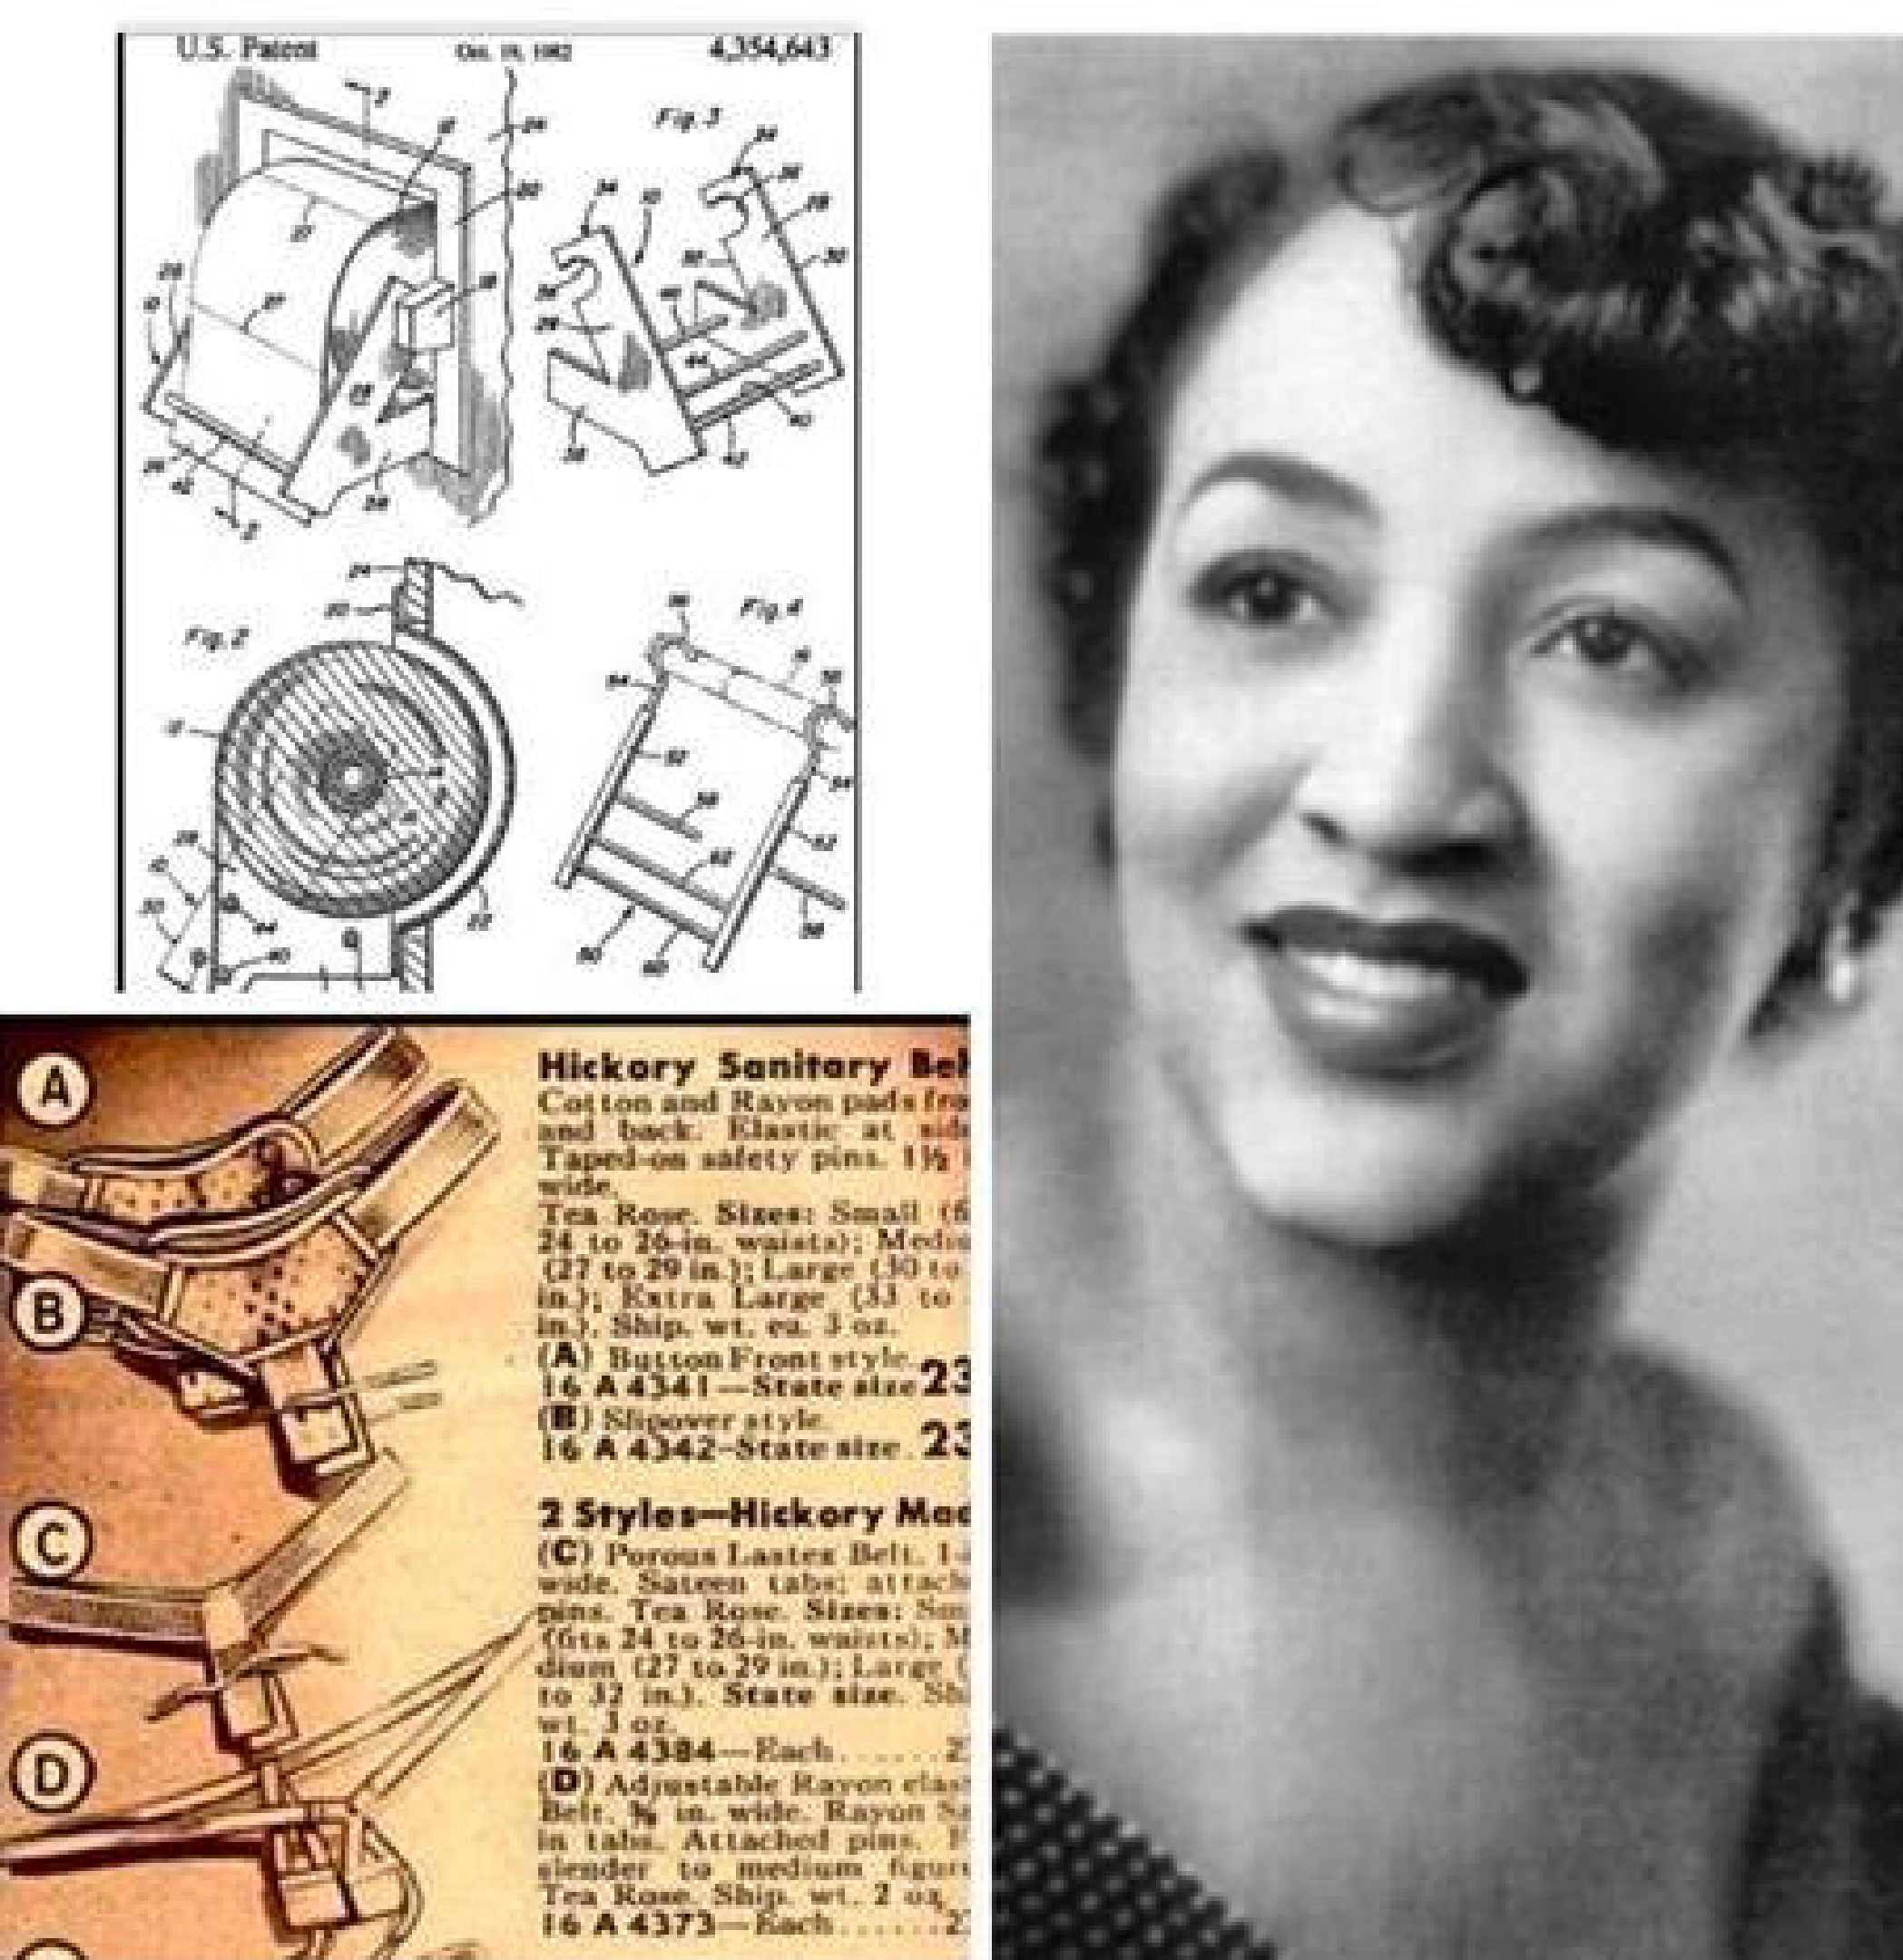
MARY BEATRICE DAVIDSON KENNER
( 1912 - 2006 )
Inventor with no formal professional training or college degree
Holds the most patents than any other Black woman in history.
Invented the menstrual sanitary belt, (precursor to menstrual pads) though it took 30 years before her invention reached mainstream markets

Slide 7

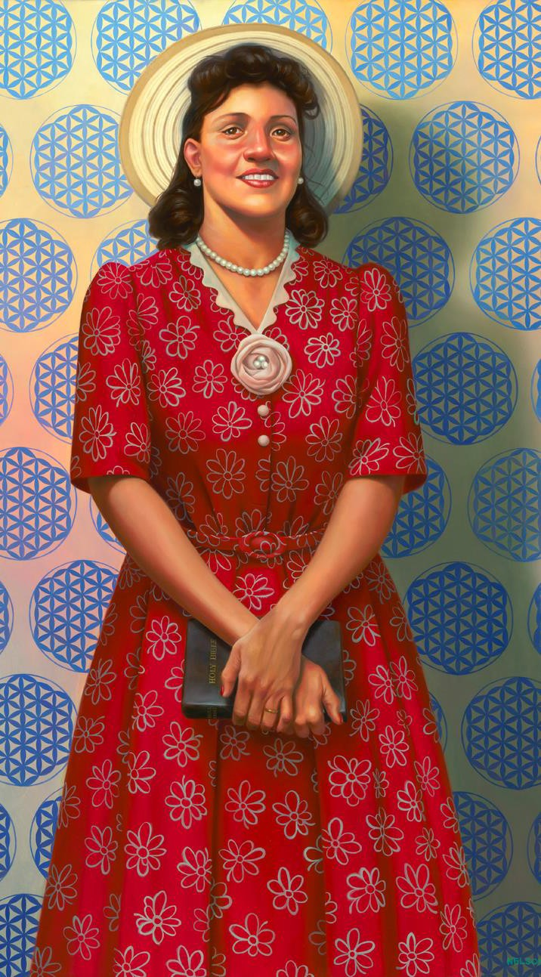
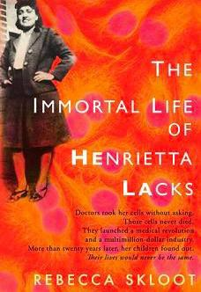
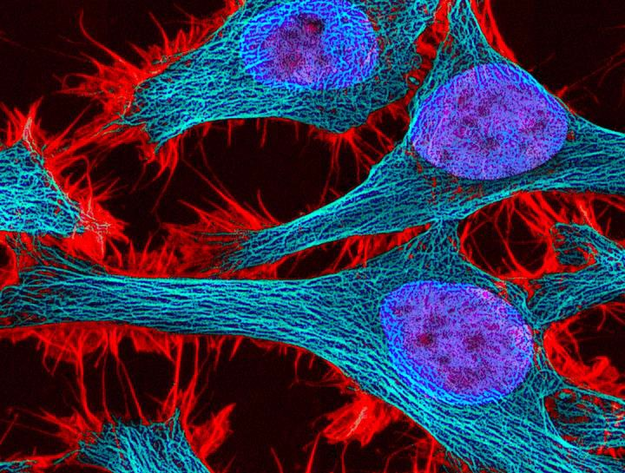
HENRIETTA LACKS ( 1920 – 1951 )
Diagnosed with cervical cancer in 1951, her cervix cells were taken for research purposes without her consent
These HeLa cells were found to reproduce indefinitely and continue to do so, hence “immortal”
HeLa cell line has contributed to biomedical breakthroughs for gene mapping, polio vaccine, and understanding cancer and HIV/AIDS
Lacks Family has received no compensation for the use of HeLa cells
Smithsonian’ s National Portrait Gallery

Slide 8
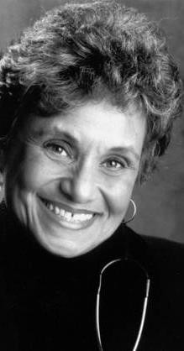
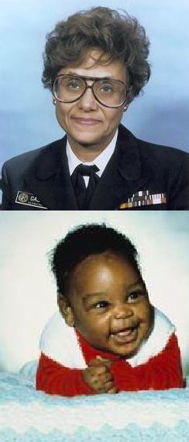

DR. MARILYN
HUGHES GASTON ( B. 1939 )
First African American woman to direct a Public Health Service Bureau
Her 1986 study of sickle-cell disease resulted in nationwide routine screening program testing newborns
2nd African American woman served as Assistant Surgeon General & achieving rank of Rear Admiral in the US Public Health Service

Slide 9
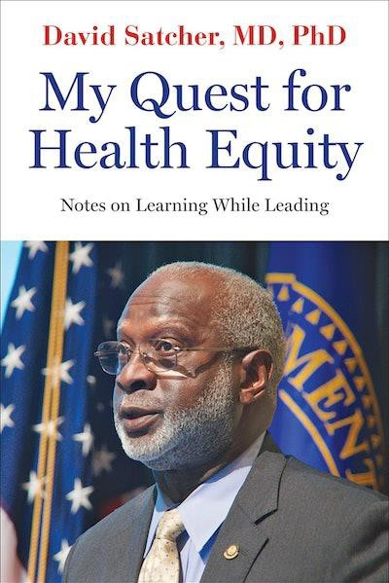
Dr. David Satcher ( b. 1941 )
Morehouse College undergraduate and an MD and PhD in cytogenetics from Case Western Reserve
Four-Star Admiral in the US Public Health Service Commissioned Corps, former CDC Director10th Assistant Secretary for Health, and the 16th US Surgeon General
1998 Surgeon General's report "Tobacco Use Among U.S.
Racial/Ethnic Minority Groups.”
Received over 50 honorary degrees
Established the Satcher Health Leadership Institute (SHLI) at Morehouse School of Medicine

Slide 10
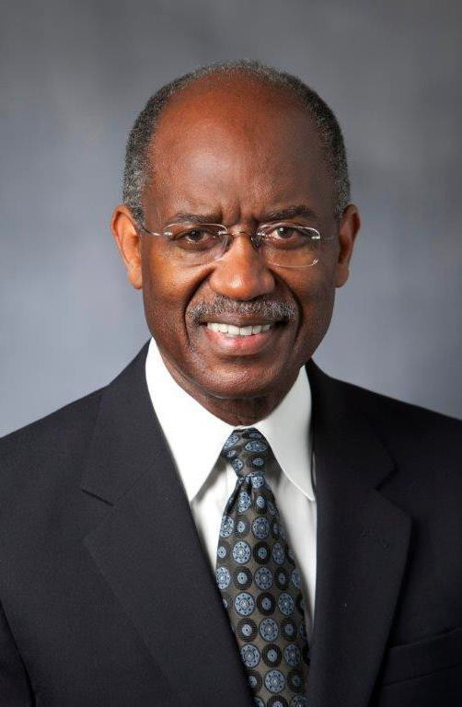
DR. SHERMAN A. JAMES
( b. 1944 )
Social epidemiologist & health researcher known for developing the John Henryism Hypothesis:
“high-effort” coping from long-term exposure to stress caused by structural racism, contributes to high risk for hypertension and cardiovascular disease to in African Americans
Susan B. King Distinguished Professor Emeritus of Public Policy at Duke University
First African American elected as president of the Society for Epidemiologic Research

Slide 11
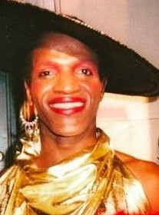
MARSHA P. JOHNSON ( 1945 – 1992 )
LGBTQ+ advocate & prominent figure in the Stonewall uprising of 1969
Co-founded Street Transvestite Action Revolutionaries (STAR), providing shelter and social supports for homeless queer youth and sex workers
AIDS activist with AIDS Coalition to Unleash Power (ACT UP)

Slide 12
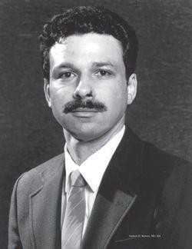

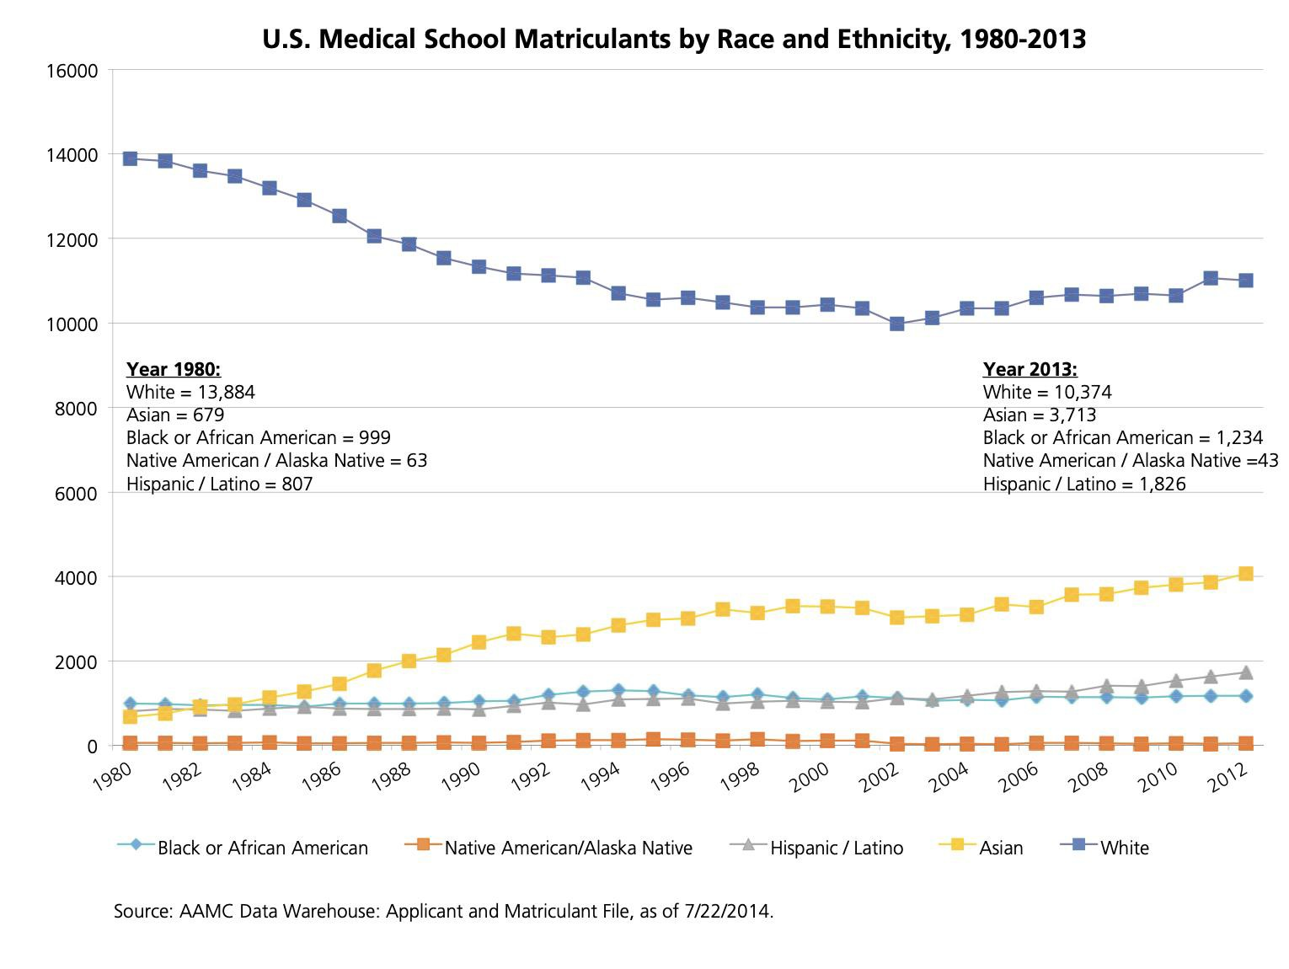
Dr. Herbert W. Nickens ( b. 1947 - 1999 )
Washington DC native, Harvard undergraduate and University of Pennsylvania trained physician with MA in sociology.
First director of the Office of Minority Health
Contributed to the “Heckler Report” of the Secretary’s Task Force on Black and Minority Health: A Summary and a Presentation of Health Data With Regard To Blacks.
Under AAMC, ed the 3000 by 2000 Project, a campaign to promote diverse enrollment into medical schools by under-represented students of color and creation of Minority Physician Database

Slide 13
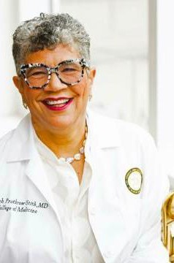

DEBORAH PROTHROW - STITH
( b. 1954 )
Graduate of Spelman College and Harvard Medical School
Authored Deadly Consequences, the first book framing violence as public health issue and social “disease” vs. criminal justice problem
First woman and youngest Commissioner of Public Health in Massachusetts
Current Dean and Professor of Medicine for the College of Medicine at Charles R. Drew University of Medicine and Science

Slide 14
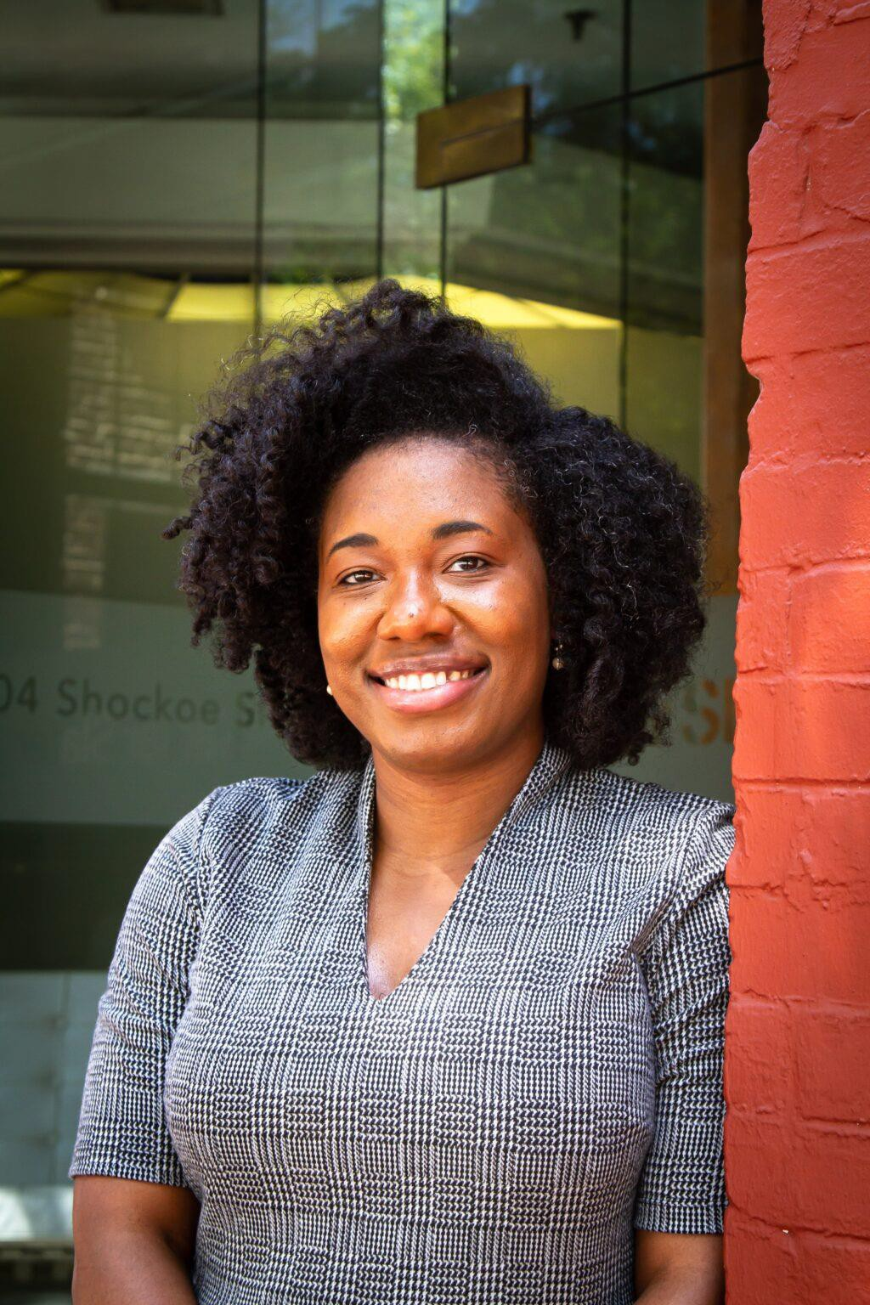
Meagan Robinson
Mississippi State undergraduate; MPH and DrPH Jackson State University
Currently serves as Virginia Department of Health’s
Division Director of Population Health Data
National Maternal and Child Health Epidemiology Early Career Professional Achievement Award
deBeaumont 40 Under 40 in Public Health

